Slide 1
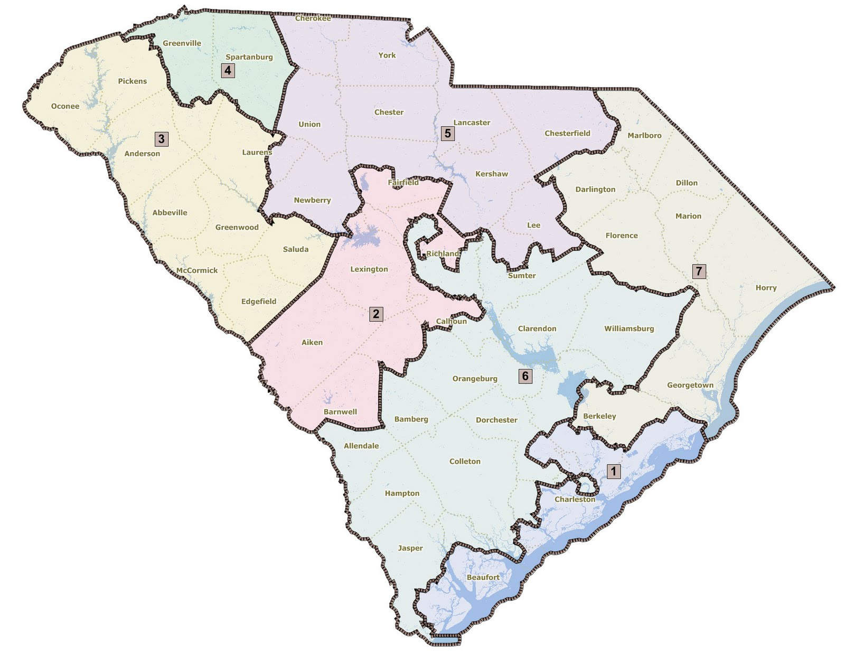
GRG Program – Fiscal Year 2024
South Carolina
Grid Resilience
Grant Program
Information
Session August 29, 2024

Slide 2
Program Timeline
Activity | Date
Information Session followed by RFP review and Q&A | August 29th
South Carolina RFP Open | August 30th
Questions Due for September 12th Session | September 10th
RFP review and Q&A Session 2 | September 12th
Eligible Entity Proposal Due | September 27th
Initial Award Notice (Proposals sent to DOE for final sign-off) | Early Nov

Slide 3
South Carolina Grid Resilience Program
Santee Cooper soliciting energy co-ops, municipalities, local utilities, transmission owners/operators, and distribution providers to apply for funding to improve the resilience of electrical grid against disruptive events and address energy justice concerns
Project Prioritization & Evaluation
Preferred Projects
Improvement to Reliability and Resiliency: Reducing the number of outages or restoration times for extreme weather events
Community Benefits Plan: Demonstrating tangible impact to the community, the community population impacted, and the overall project cost in relation to overall impact
Project Definition and Information Available: Level of detail around project scope, budget/cost development, project partners, and timeline for implementation
Technological and Operational Complexity: Assessing the communications network, staffing plans, and organizational competencies for similar project types
Targeting Resiliency Improvements: Increasing Design Standards of Equipment (Projects which enhance the specifications and requirements for critical distribution equipment to improve system performance), Flooding Protection (Projects which offer protection against storm surge in coastal areas and inland flooding), DER Solutions (Projects incorporating FTM or BTM DER assets for residential and commercial customers)
Targeting Reliability Improvements: Sectionalizing Grid (Projects which protect the grid by isolating faulted sections from the rest of the distribution system), Adding Smart Technology (Projects which increase monitoring and control capabilities)

Slide 4
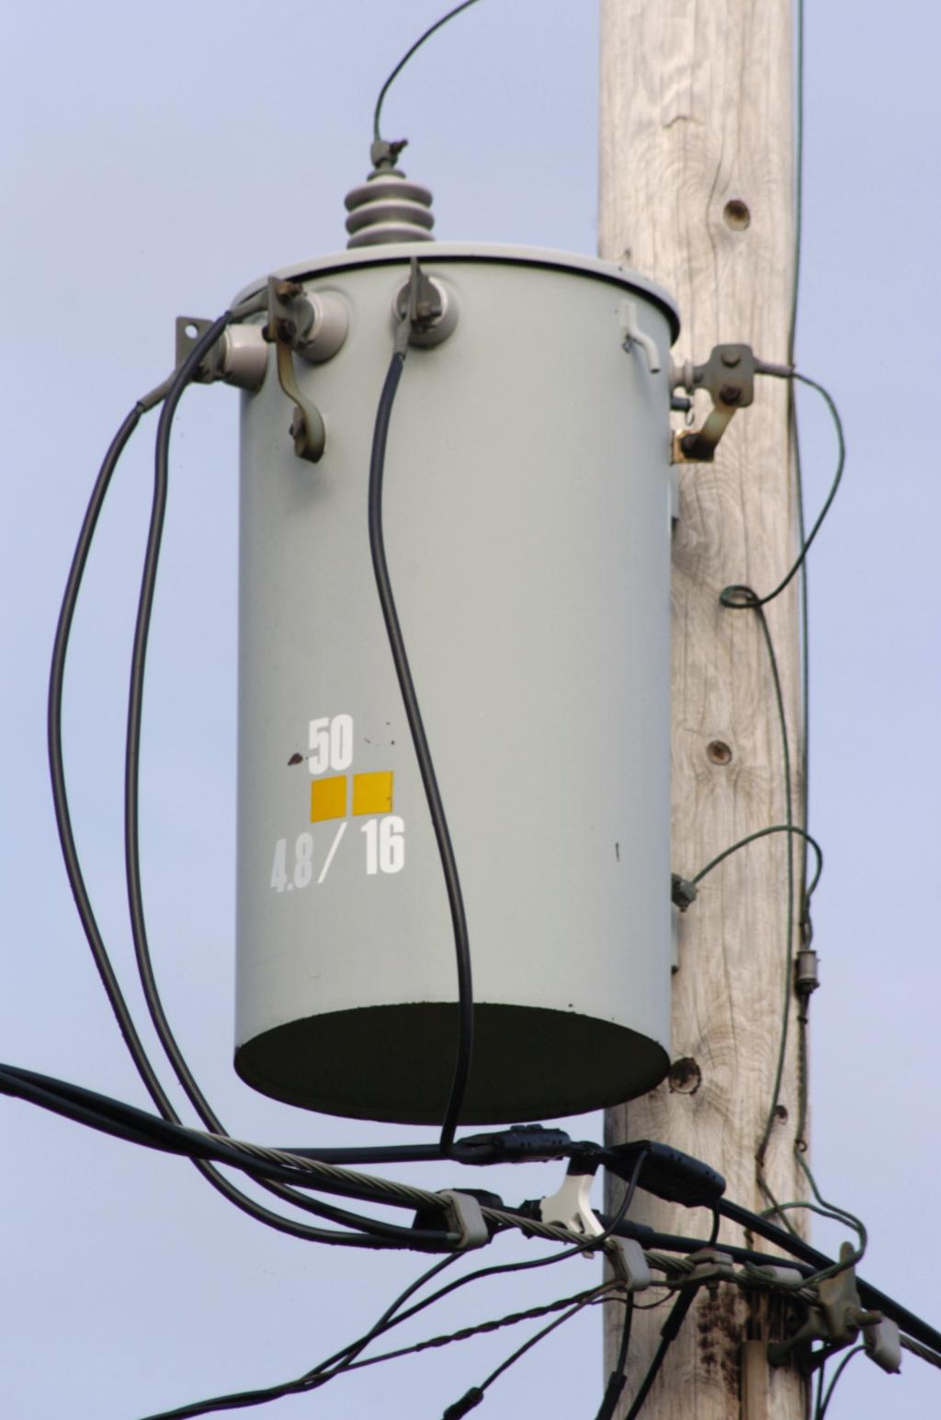
South Carolina Grid Resilience Program
BIL 40101(d) - Grid Resilience from disruptive events (i.e. weather and Act of God)
Santee Cooper application approved and funded July 10, 2024 for Year 3 (FY 2024)
Total funding = $6,276,979
Grant amount $5,458,242 with 15% match of $818,737 (Santee Cooper)
Project Proposals awarded initially by Santee Cooper must be presented to DOE for final sign-off
Projects should contain realistic and verifiable metrics to show areas of impact and improvement – focus on areas most affected by extreme weather events.
Key areas of project consideration:
Overall Project Impact (geographically, financially, # of customers affected, and overall impact to the grid)
Community Benefit

Slide 5
Proposed GRG Project Objectives
Objective #1 – Increased Monitoring & Control Capabilities
DRAFT METRICS
Increased number of:
Monitored facilities
Facilities under centralized control
Automated line miles
Customers benefiting from increased automation -- broken out by customers in disadvantaged/ underserved communities
Improved situational awareness / visualization for operators
PROPOSED OBJECTIVE STATEMENT
Increased monitoring and control capabilities to provide visualization and enhance situational awareness leading up to, during, and post-extreme weather events
ANTICIPATED PROJECT TYPES
Installations such as
expansion of Distribution Automation or Distribution Management Systems
equipment for remote facility operation
line monitoring equipment
remote controlled sectionalizing devices

Slide 6
Proposed GRG Project Objectives
Objective #2 – Harden or Adapt Electric System
PROPOSED OBJECTIVE STATEMENT
Harden or adapt the electric system to increase resiliency during extreme weather events
DRAFT METRICS
Avoiding or reducing consequences to:
Key electric infrastructure – reductions in outage events & permanent facility damage
Disadvantaged communities – expected reductions in SAIDI & CAIDI
Priority customers – reduction in # / duration of outages, impacts, emphasis on disadvantaged communities
Key geographic areas – avoiding wage loss & production due to disruptions
Reduction in average electric infrastructure age
Increase in % of underground line miles vs total
Reduction in # of radial line miles
ANTICIPATED PROJECT TYPES
Overhead to underground conversion
Upgrades of overhead facilities, such as lines and substations
Construction of redundant paths

Slide 7
Proposed GRG Project Objectives
Objective #3 – Enhance Vegetation / Minimize Risk
PROPOSED OBJECTIVE STATEMENT
Enhance vegetation management programs to reduce exposure to tree-related damage to the electric system during extreme weather events or wildfires
DRAFT METRICS
Refined & optimized vegetation management
# miles cleared / # danger-trees removed
Reduction in # exposed miles / customers
Reductions in # of predicted vegetation-related outages during extreme weather events
ANTICIPATED PROJECT TYPES
Advanced technology(ies) to improve vegetation practices (AI, satellite analytics, modeling)
Reclassification & removal of danger trees
Analytics-based adjustments to tree trimming activities to reduce vegetation risks
Reconfiguration or relocation of lines

Slide 8
Proposed GRG Project Objectives
Objective #4 – Develop Energy Storage or Microgrids
PROPOSED OBJECTIVE STATEMENT
Develop energy storage & microgrids to provide system adaptive capacity to increase resilience for communities and customers – e.g., systems able to provide electrical energy during disruptions
DRAFT METRICS
Number of
MWh of resilient energy supply
Resilient customers due to installation
residents benefitting from public facilities – hospitals, fire, police, shelters
more resilient community / essential locations – community centers, long-term care facilities
underserved residents benefitting from resilient supply
ANTICIPATED PROJECT TYPES
Development of a microgrid(s)
Installation of battery storage at substations to serve load
Installation of distributed battery storage at critical facilities or customer locations to power the site

Slide 9
Proposed GRG Project Objectives
Community Benefits
PROGRAM OBJECTIVE STATEMENT
Use compliant labor standards and protections (including for direct employees, contractors, and sub-contractors), such as using project labor agreements, local hire agreements, and an outline of a plan to attract, train, and retain an appropriately skilled workforce (i.e., through registered apprenticeships and other joint labor-management training programs that serve all workers, particularly those underrepresented or historically excluded)
Include “plans to partner with a training provider (labor, community college, etc.)”
Assure “the use of an appropriately credentialed workforce (i.e., requirements for appropriate and relevant professional training, certification, and licensure)”

Slide 10
RFP Documentation Requirements
DOCUMENTATION | REQUIREMENTS | FORMAT
Form 1 Resilience Project & Subaward Notification Form | Complete full form
Form 2 Secretarial Eligible Entity Designation Form | Complete full form
Form 3 Environmental Questionnaire (NEPA) | Complete full form
Form 4 SF-424 Budget Justification Workbook | Complete full form
Form 5 Cost match commitment letter | Complete full form
Form 6 Appendix A – Performance Metrics to Evaluate Utility Resilience Investments | As Applicable
Form 7 Acknowledgement of federal funds governed by DE-FOA-0002736 | Complete full form
Form 8 SF-LLL: Disclosure of Lobbying Activities (if applicable) | If Applicable
Form 9 Letters of Support (if applicable) | If Applicable

Slide 11
RFP Review Process
Review consists of two steps to ensure an efficient and effective evaluation process for respondents
STEP1: SCREENING CRITERIA
Is the application complete?
Does the response meet 1 of the 4 objectives?
Does the application meet workforce standards
STEP 2: PROPOSAL EVALUATION CRITERIA
Evaluate the proposed improvements of the submitted projects and proposed metrics for tracking against a weighted scoring system; Also, review to determine if applicant is a prior sub-awardee or new applicant or new geographic location.
PROJECT RESILIENCY IMPACT (60%)
COMMUNITY BENEFIT IMPACT (40%)
Does the project demonstrate significant improvements to:
Reduce the number of outages due to extreme weather events
Improve the restoration times due to extreme weather events
Does the project demonstrate community benefits in any of key areas:
Community population impacted beneficially
Community and Labor Engagement
Workforce Continuity and Good Jobs Plan:
Diversity, Equity, Inclusion, and Accessibility (DEIA) Plan:
Justice40 Initiative

Slide 12
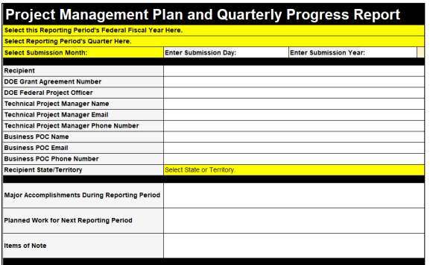
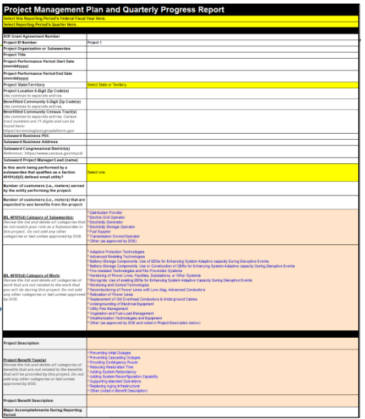
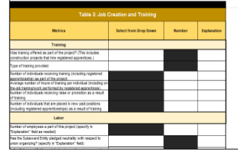
Department of Energy Reporting Requirements
Project Management Plan
Quarterly Reporting
Annual Report
Due 90 days after effective award date
Due 30 days after the end of each Quarter
Due 30 days after reporting year (October 1 – September 30)
Form-based response collecting information related to award, administration budget, customer impact, project milestones, contracts, impact metrics, overall and risks
Form-based report includes impacts (e.g., performance metrics), job creation, workforce demographics, and community engagements
Project-specific information and updates related to project build, resilience impact, and financial reporting
More information found at - https://netl.doe.gov/bilhub/grid-resilience/formula-grants/post-award-documents

Slide 13
RFP and Associated Documents
Next steps and where to find the RFP & Associated Documents:
RFP Opened for all eligible entities on August 30, 2024 and all proposed applications are due by 5:00 pm on September 27, 2024.
Santee Cooper will host another virtual RFP Review and Q&A September 12, 2024, please submit all questions to gridresiliencegrant@santeecooper.com no later than September 10, 2024.
All project submission related questions and proposed projects should be sent to Santee Cooper at the following email address: gridresiliencegrant@santeecooper.com
(Please clearly state in the subject line whether you are submitting a question or final application)
A recording of this information session, the RFP application and associated documents will be posted and made publicly available at: SanteeCooper.com/GridResilienceGrant
Additional information regarding the federal requirements and assistance can be found at https://netl.doe.gov/bilhub/grid-resilience/formula-grants/post-award-documents

